Slide 1

C PROJECT BATCH

Slide 2


CHAPTER 2
FILE HANDLING BASICS
Topics Covered
What Is File Handling?
Why To Use File Handling?
How C Handles Files ?
Steps Required In File Handling
File Opening Modes

Slide 3
What is a File?
A file is a collection on information, usually stored on a computer’s disk. Information can be saved to files and then later reused.

Slide 4
Why We Need File Handling ?
Files are places where data can be stored permanently.
Some programs expect the same set of data to be fed as input every time it is run.
Cumbersome.
Better if the data are kept in a file, and the program reads from the file.
Programs generating large volumes of output.
Difficult to view on the screen.
Better to store them in a file for later viewing/ processing

Slide 5
How C Handles Files ?
C uses a structure called FILE (defined in stdio.h) to store the attributes of a file.
C provides a number of functions that helps to perform basic file operations.
Following are these functions:
fopen() create a new file or open a existing file
fclose() closes a file
fgetc() reads a character from a file
fputc() writes a character to a file
rewind() set the position to the beginning point
fscanf() reads a set of data from a file
fprintf() writes a set of data to a file
fseek() set the position to desire point
ftell() gives current position in the file

Slide 6
Steps in Processing a File
Create the stream via a pointer variable using the FILE structure: FILE* fp;
Open the file, associating the stream name with the file name.
Read or write the data.
Close the file.

Slide 7
File Open
The file open function (fopen) serves two purposes:
It makes the connection between the physical file and the stream.
It creates “a program file structure to store the information” C needs to process the file.
Syntax: fopen(“filename”, “mode”);

Slide 8
More On fopen
The file mode tells C how the program will use the file.
The filename indicates the system name and location for the file.
We assign the return value of fopen to our pointer variable:
fp = fopen(“data.txt”, “w”);
fp = fopen(“D:\\data.txt”, “w”);

Slide 9
More On fopen

Slide 10
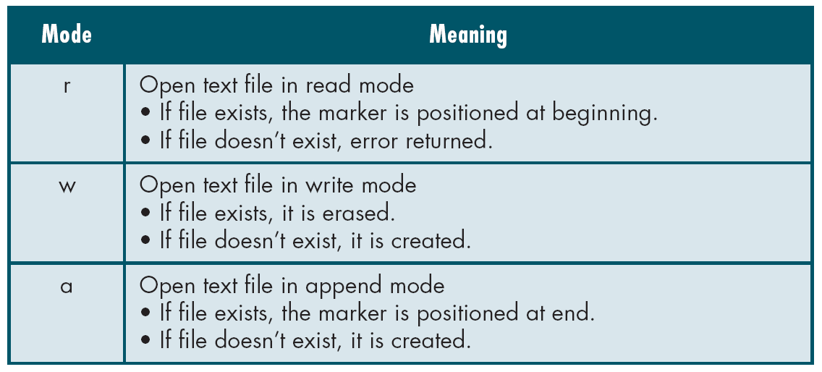
File Open Modes

Slide 11
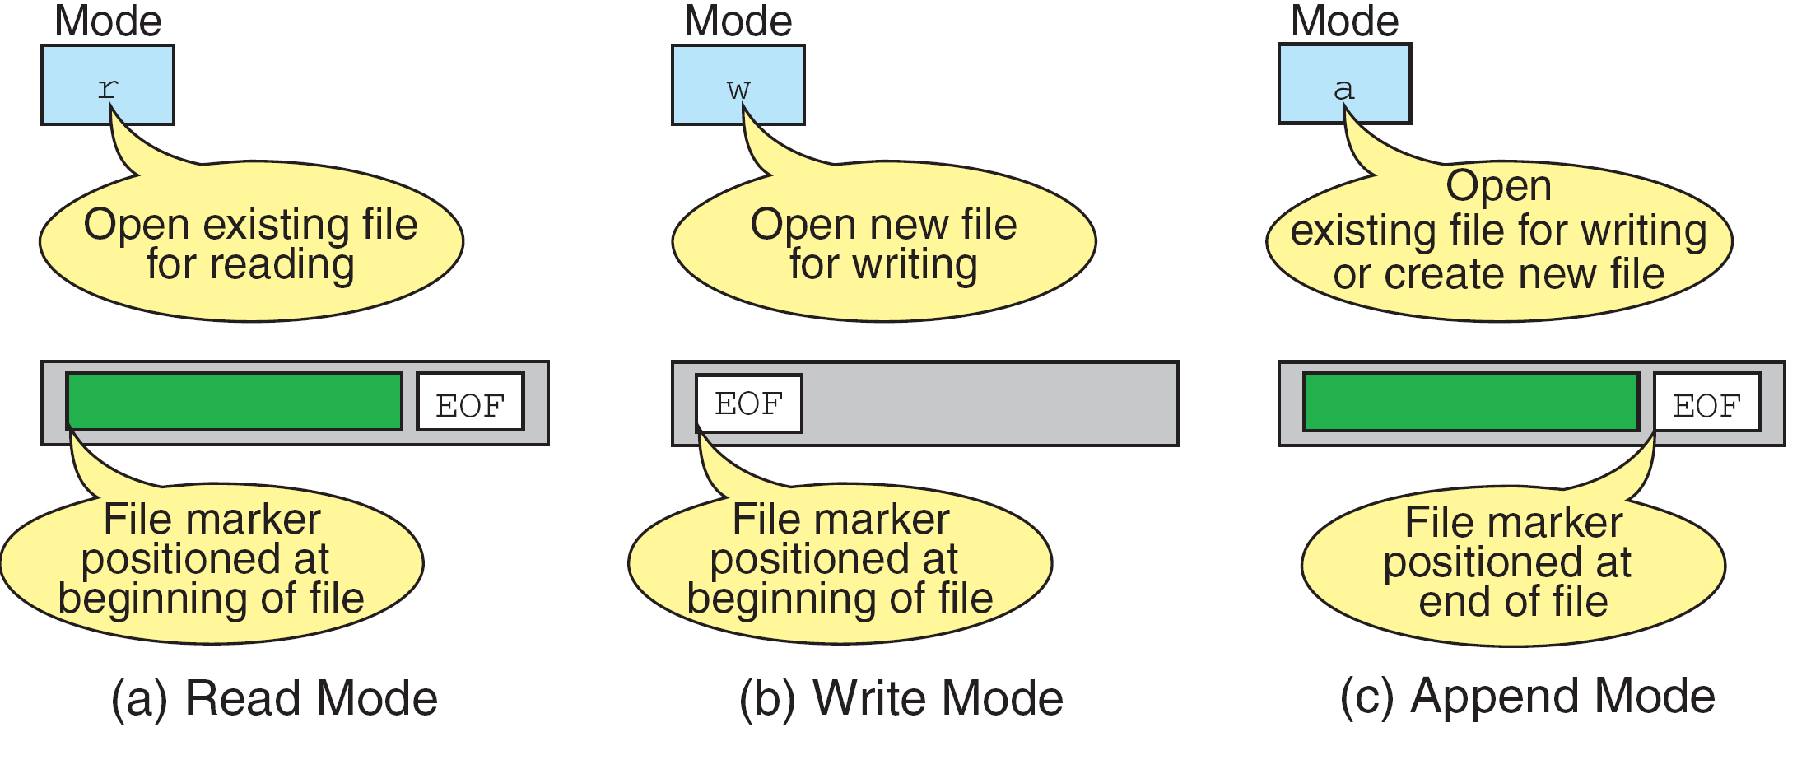
More on File Open Modes

Slide 12
Some More Modes
r+ - open for reading and writing, start at beginning
w+ - open for reading and writing (overwrite file)
a+ - open for reading and writing (append if file exists)

Slide 13
Closing a File
When we finish with a mode, we need to close the file before ending the program or beginning another mode with that same file.
To close a file, we use fclose and the pointer variable: fclose(fp);

